Slide 1
Objectives
In this session, you will:
  Understand the importance of effective telephone handling skills
  Understand the guidelines of making and receiving a call
  Understand the guidelines to take and leave a message
  Understand the importance of voice modulation
  Appreciate the mute, hold, and transfer protocols
  Identify the essential telephone listening skills
  Deal with different accents
  Understand different behavioural patterns in a telephonic conversation
  Identify annoying telephone manners
Notes:
In the current fast-paced and materialistic era, time is money and the business operations are becoming more and more complex each day. The telephone thus becomes an important communication tool for all of us to keep pace with the existing business scenario. Every time you make or receive a call, you represent your organization and yourself. The person on the other end of the line cannot see you, so the impression you make depends on your voice and telephone manners.

Slide 2

Importance of Effective Telephone Handling Skills
The telephone is being used more and more as the primary means of contact with business associates, customers, and suppliers.
If the call is not handled properly, the caller gets a poor impression of the company.
The callers must be made to feel that they are important for the organization to succeed.
Notes:
Encourage the students to come out with how telephone has become an integral part of our lives, and more so, how imperative it is for an organization.

Slide 3

Activity: Analyzing Telephone Service Scenarios
In this activity, you will learn to identify the elements of both good and bad communication.

Slide 4

Making a Telephone Call
The entire process of making a telephone call involves four phases:
  Planning your call
  During the call
  Closing the call
  After the call

Slide 5

Planning your Call
While planning a call, it is important to focus on the following points:
  Identify a convenient time not only for yourself but also for your customer whom you call.
  Identify what you want to achieve through the call. Make notes if necessary.
  Find and gather all available supporting or background information.
Notes:
You may use the following example:
Sanjay Gupta is working as a sales executive in one of the leading credit card providers. He needs to give a call to Neeta Raina, a development manager, in order to let her know about some of the attractive schemes that she can avail of. He does some research by viewing her case history in the company’s database and discovers that Neeta works from Monday till Friday and is mostly at home over the weekends. Also, he finds out that she needs a platinum credit card. So, he decides to give her a call on Saturday morning and inform her about:
The brand new platinum card launched by their company.
The innumerable schemes that are offered along with the card.

Slide 6
During the Call
During the call, it is important to focus on the following points:
  Identify yourself and your organization.
  State the purpose of your call.
  Verify the authorized person.
  Listen to the caller carefully.
  Wait for a response after you make an opening.
  Always ask for the customer’s consent before providing a solution to the problem.
  Be concise, polite, and pleasant.
  Smile as it can be heard over the telephone.

Slide 7
Closing the Call
While you are closing the call, it is important to focus on the following key points:
  Summarize and reconfirm on what has been agreed upon.
  Repeat any identified action that has to be carried out by both of you.
  Thank the customer pleasantly.
  Ask if there is anything else you can help the customer with.
  Let the customer hang up first.
Notes:
Emphasize that let the customer hang up first as it is considered to be an abuse when you hang up the phone before the customer hangs up as it is considered to be an abuse when you hang up the phone before the customer hangs up.

Slide 8
After the Call
After ending the call, it is important to focus on the following points:
  Take any follow-up action that is necessary.
  Fulfill any promises that you have made especially regarding services, dates, and time.

Slide 9
Receiving a Telephone Call
You should adhere to the following guidelines while receiving a call:
  Greet the caller.
  Introduce yourself and organization/department.
  Identify the caller.
  Understand the caller’s request.
  Check if you are the right person to help the caller.
  If the call is not for you, pass the call to the intended recipient.
  Perform the agreed action.

Slide 10
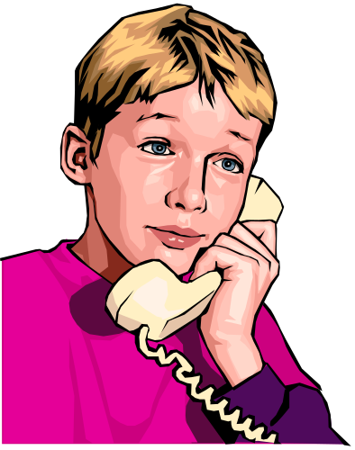
Activity: Receiving a Call
In this activity, you will learn to receive a call effectively.

Slide 11
Taking a Message
While taking a message, you should be careful of the following rules:
  Be clear on the message and its intended recipient.
  Write out a legible message and address it clearly.
  Place the message at the designated place.
  Follow up on your commitment to the caller to close the transaction.

Slide 12
Leaving a Message
To leave a message, you need to use the voicemail facility of the telephone.
To leave an effective voicemail, you need to perform the following steps:
  Initiate the message by greeting the person.
  Identify yourself.
  Specify the reason as to why you are calling.
  Give your contact information and ask the person to call you back if he/she needs more information.
  Close the message by showing courtesy.

Slide 13
Leaving a Message (Contd.)
You should take care of the following points while recording the message:
  Be short, clear, and informative.
  Include your name and organization, and the date and time of the recording.
  Include details of your availability.
  Include another contact number.
  Refresh the message daily or as frequently as required.
  Identify the key(s) callers can press on their telephone for immediate assistance from an operator.

Slide 14
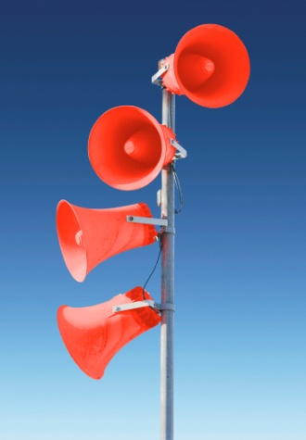
Importance of Voice Modulation
Voice modulation implies the manner of speaking in which the various factors such as loudness, pitch, or tone of the voice is modified.
The factors, which define our voice or voice quality, are:
  Intonation
  Pitch
  Volume
  Speed

Slide 15
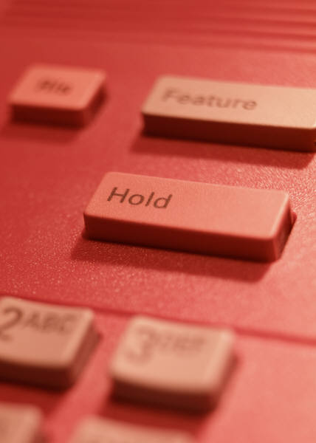
The Mute, Hold, and Transfer Protocols
Protocol can be defined as set of rules.
Some of the protocols that are used frequently over the telephone are:
  Mute
  Hold
  Transfer

Slide 16
Using the Mute Facility
The mute facility is used if you want to put the caller on hold for less than 30 seconds.

Slide 17
Using the Hold Facility
The hold facility is used if you want to put the caller on hold for more than 30 seconds.
While using the hold facility, you need to:
  Seek permission before putting the caller on hold.
  Inform the caller about the probable duration that the caller will be on hold.
  Specify the reason as to why you are putting the caller on hold.
  Thank the caller for being on hold.

Slide 18
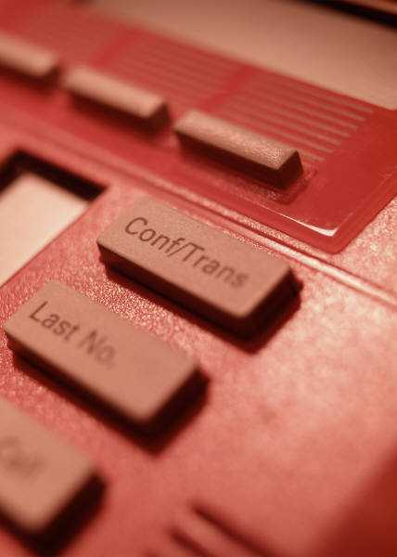
Using the Transfer Facility
The transfer facility is used when you are not the actual person the caller wants to speak to.

Slide 19
Activity: Hold and Transfer
In this activity, you will perform the following tasks:
  Part 1: List the situations when you need to place the customer on hold and when you need to transfer the call.
  Part 2: Perform a role-play based on these situations.

Slide 20

Telephone Listening Skills
Some tips for improving telephone listening skills are:
  Prepare in advance.
  Focus on the call.
  Take notes.
  Ask questions.
  Visualize the caller.
  Use receptive language cues.
  Listen between the lines.
  Improve your listening skills.

Slide 21
Telephone Listening Skills (Contd.)
You can confirm your understanding through the following steps:
  Use a confirming statement.
  Summarize the key facts.
  Ask, if your understanding is correct.

Slide 22
Dealing with Different Accents
Accent is a manner of pronouncing words that reflects the native place or social background of the person.
Some tips for better understanding and handling of different accents are:
  Cultivate a rapport.
  Politely ask the caller to speak more slowly.
  Avoid jargon and slang.
  Confirm if the caller has understood you.
  Summarize the key points.
  Be patient.
  Spell your name and say it slowly.

Slide 23



Understanding Different Behavioral Pattern
Every individual has a different behavioral pattern and it is reflected in their communication.
The three different behavioral pattern that reflect in a telephonic conversation are:
  Passive
  Aggressive
  Assertive

Slide 24
Activity: Understanding Different Behavioral Patterns
In this activity, you will learn to identify and understand the three different behavioral pattern that reflect in a telephonic conversation.

Slide 25
Annoying Telephone Manners
Some annoying telephone manners that the caller needs to be aware are:
  Not identifying yourself
  Not returning telephone calls
  Putting the customers on hold for a long time
  Not asking polite questions
  Not using technology smartly
  Disinterested tone
  Eating while talking

Slide 26
Summary
In this session, you learned that:
  The telephone is being used more and more as the primary means of contact with your business associates, customers, and suppliers.
  The entire process of making the telephone call involves four phases:
    Planning your call
    During the call
    Closing the call
    After the call
Notes:
Use this and the following slides to summarize the key concepts of the session to the students.

Slide 27
Summary (Contd.)
  You should adhere to the following guidelines while receiving a call:
    Greet the caller.
    Introduce yourself and organization/department.
    Identify the caller.
    Understand the caller’s request.
    Check if you are the right person to help the caller.
    If the call is not for you, pass the call to the intended recipient.
    Perform the agreed action.
  The factors, which define our voice or voice quality, are:
    Intonation
    Pitch
    Volume
    Rate

Slide 28
Summary (Contd.)
  Some of the protocols that are used frequently over the telephone are:
    Mute
    Hold
    Transfer
  Some tips for telephone listening skills are:
    Prepare in advance
    Focus on the call
    Take notes
    Ask questions
    Visualize the caller
    Use receptive language cues

Slide 29
Summary (Contd.)
    Listen between the lines
    Improve your listening skills
  Some tips for better understanding and handling of different accents are:
    Cultivate a rapport
    Politely ask the caller to speak more slowly
    Avoid jargon and slang
    Confirm if the caller has understood you
    Summarize the key points
    Be patient
    Spell your name and say it slowly

Slide 30
Summary (Contd.)
  The three different behavioral pattern that reflect in a telephonic conversation are:
    Passive
    Aggressive
    Assertive
  Some annoying telephone manners that the caller needs to be aware are:
    Not identifying yourself
    Not returning telephone calls
    Putting the customers on hold for a long time
    Not asking polite questions
    Not using technology smartly
    Disinterested tone
    Eating while talking

